Slide 1
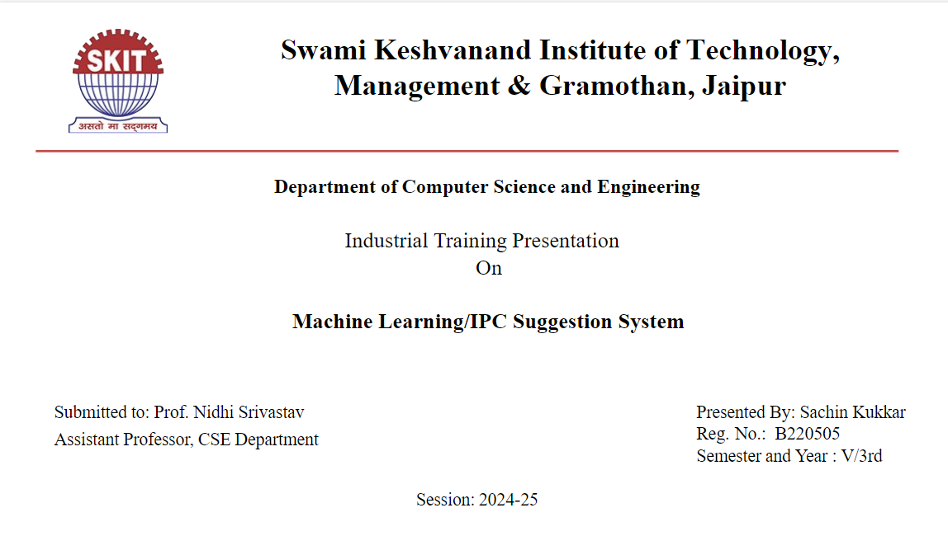

Slide 2














Machine Learning for Crime Description Analysis
Presented by Sachin Kukkar :-)

Slide 3

Objective of the creative idea
The objective of this project is to use machine learning to identify relevant IPC sections based on crime descriptions. It provides details on the applicable section, punishment, and whether the offense is bailable or cognizable, helping streamline legal interpretations and improve accessibility

Slide 4

Introduction to the Application
1.ML Integration
2.IPC Section Identification
Utilizes advanced algorithms to analyze crime descriptions, improving accuracy in legal assessments.
Automatically identifies relevant IPC sections based on input crime descriptions for efficient processing.
3.Punishment Outlining
4.Bailability and Cognizability
Provides clear outlines of potential punishments associated with identified offenses for informed decision-making.
Determines whether offenses are bailable or non-bailable, and cognizable or non-cognizable, enhancing legal clarity.
5.Streamlining Legal Processes
Aims to simplify legal workflows, aiding law enforcement in quick and accurate decision-making.

Slide 5
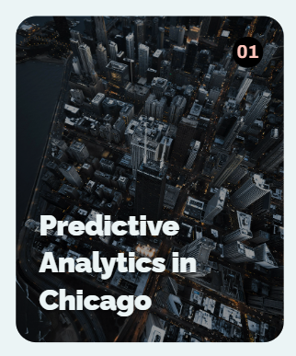
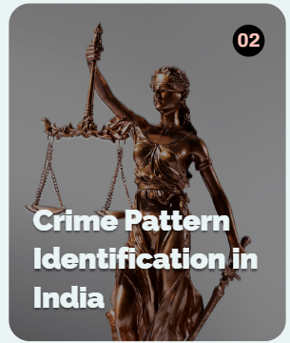

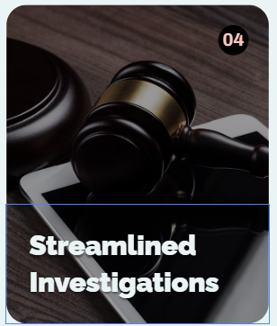
Real-World Applications Examples
The Chicago Police Department leverages predictive analytics to deploy officers effectively, optimizing crime prevention strategies.
Indian law enforcement utilizes advanced technology to detect crime patterns, enhancing the efficiency of investigations and resource management.
Machine learning allows for improved allocation of law enforcement resources, ensuring that areas with high crime rates receive adequate attention.
Technology aids in streamlining investigations by quickly analyzing large datasets, leading to faster resolution of cases.

Slide 6





User Interface Overview
User-Friendly input
Instant
Legal
Feedback
Usability for Law Enforcement
Comprehensive Crime Analysis

Slide 7
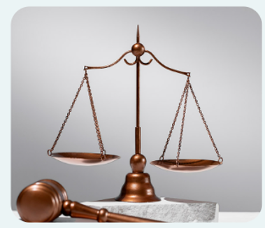
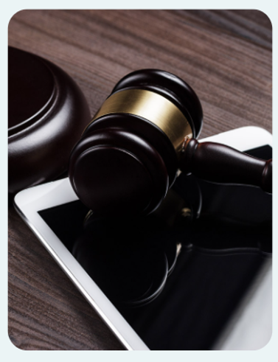
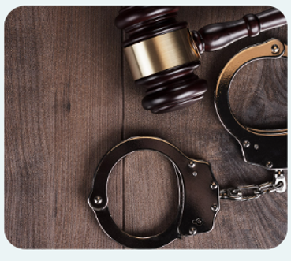
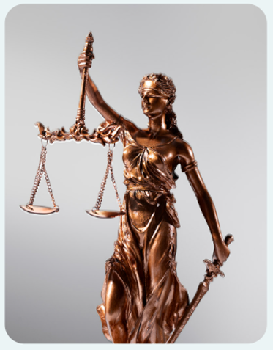
Output Features of Application
IPC Section
Identification
Bailability
Status
Legal
Consequences
Cognizability
Classification

Slide 8

Machine Learning Techniques Used
Enhanced Usability
Supervised Learning
By employing ML techniques, the application becomes more user-friendly and effective for legal professionals.
Utilizing labeled datasets helps train models to make accurate predictions, crucial for legal contexts.
Accuracy in Predictions
Natural Language Processing (NLP)
These techniques significantly improve the application's accuracy in identifying IPC sections related to crimes.
NLP enables the application to understand and interpret human language, enhancing user interactions.

Slide 9
1.Data Privacy Concerns
Safeguarding sensitive information is vital in legal contexts, ensuring compliance with regulations.
Challenges
in Implementation
2.Model Bias
Ensuring fairness and accuracy in predictions
is crucial to avoid discriminatory outcomes in
legal decisions.
Exploring the Barriers
to Machine Learning
in Legal Contexts
3.Integration with Existing Systems
Harmonizing new technology with current practices is essential to enhance workflow without disruption.

Slide 10

Traditional Methods
1.Significant dependence on human interpretation
2.Lengthy procedures result in delayed results
3.Reduced accuracy stemming from human error
4.Restricted scalability when handling large datasets
Machine Learning Approaches
1.Faster data processing capabilities enhance efficiency.
2.Higher accuracy rates reduce error margins significantly
3.Scalability allows handling of large datasets effortlessly
4.Objective analysis reduces bias and improves reliability.

Slide 11
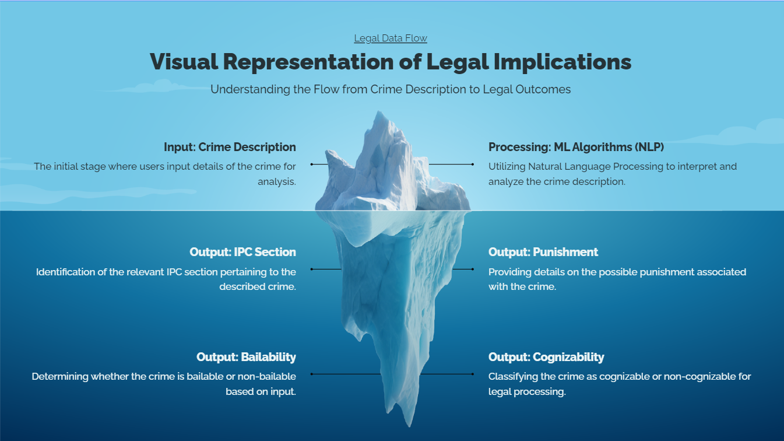

Slide 12

Ethical Considerations in ML :
Model Transparency
Biases in Training Data
Transparency in algorithms is crucial for accountability. Clear model explanations help users trust and understand decisions.
Addressing biases ensures fair outcomes. Diverse data sets can reduce discrimination and enhance model performance.
Upholding Data Protection Laws
Promoting Ethical Use of ML
Compliance with data protection regulations fosters public trust. Adhering to legal standards is paramount in ML applications.
Encouraging ethical practices in AI usage safeguards rights. Establishing guidelines ensures responsible deployment of ML technologies.

Slide 13
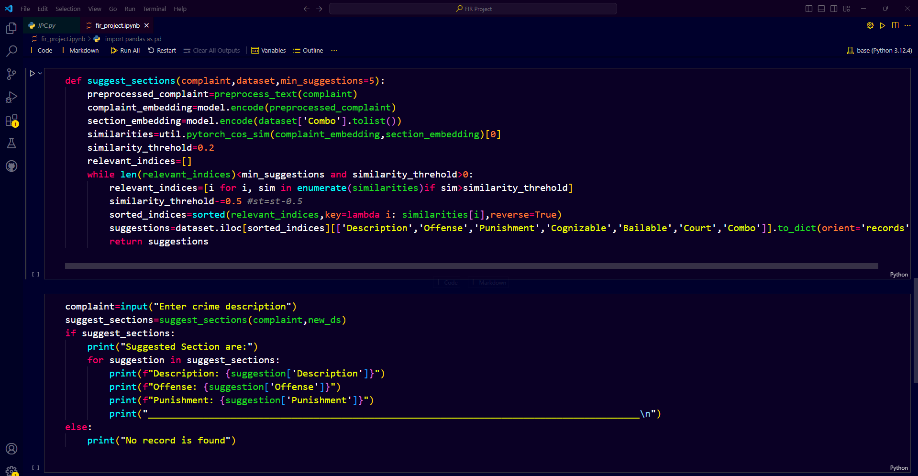

Slide 14
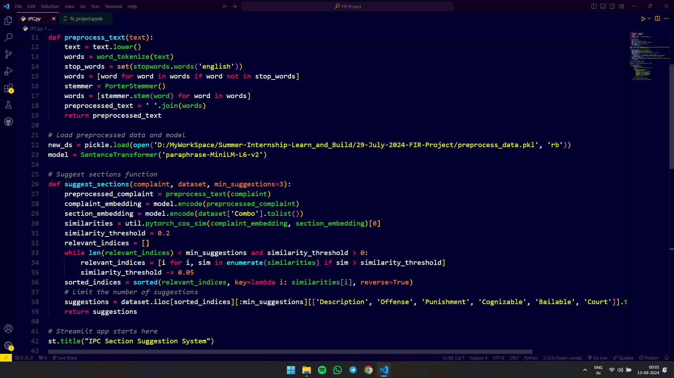

Slide 15
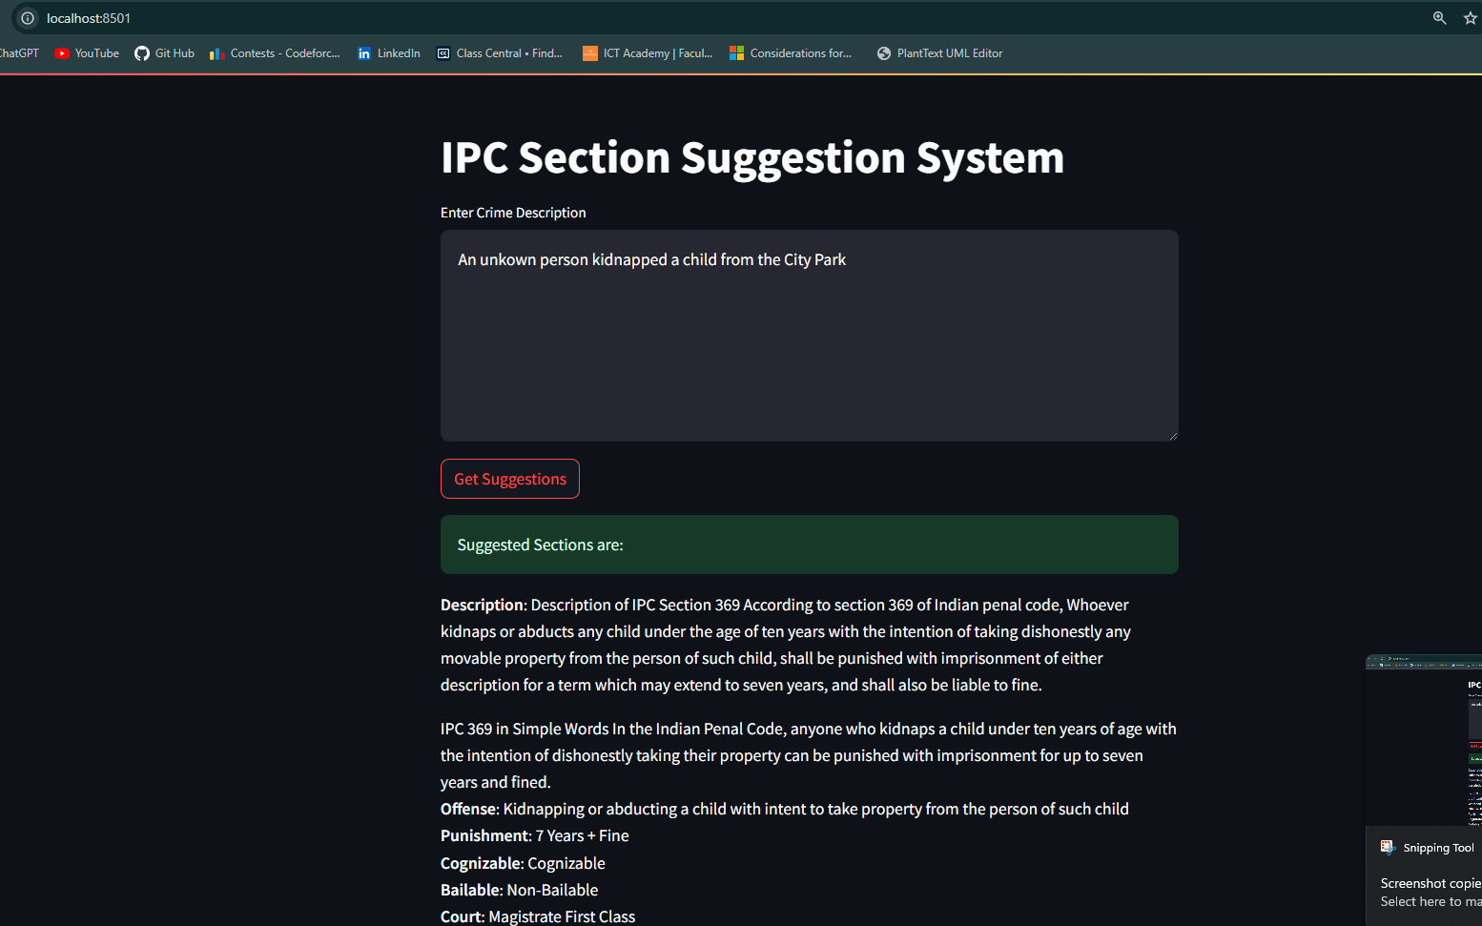

Slide 16





Future Directions in Machine Learning for Law
Enhanced
Algorithms
AI and Big Data
Integration
Domain Specific
Models
Predictive
Analystics in law
Real-Time Crime
Analysis

Slide 17
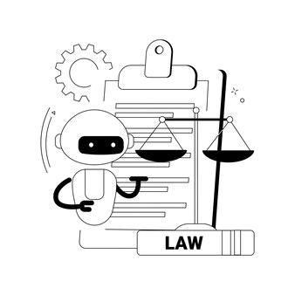
The future of law lies in our ability to adapt and innovate through technology.

Slide 18
Conclusion: Transforming Legal Processes
This project leverages machine learning to transform crime analysis and legal interpretation in law enforcement. By automating the identification of IPC sections, punishments, and offense classifications, it aims to enhance the efficiency and accessibility of legal processes. This innovation could improve interactions among legal professionals, law enforcement, and the public, fostering a more effective and user-friendly legal system.

Slide 19
Thank you very much!
I Welcome Your Inquiries ;-)

